Slide 1
How to use a normalization rule when importing a record from search external resources
Yoel Kortick. Senior Librarian

Slide 2
Introduction
Creating the normalization rule
Adding the normalization rule to a process
Add normalization process to external resource
Testing the normalization process in external resource

Slide 3
Introduction
There are cases where institutions import records from “another” catalog and want to edit the record as it is imported.
In this way the record will be imported from the external catalog with local changes, such as the removal, addition or changing of fields.

Slide 4
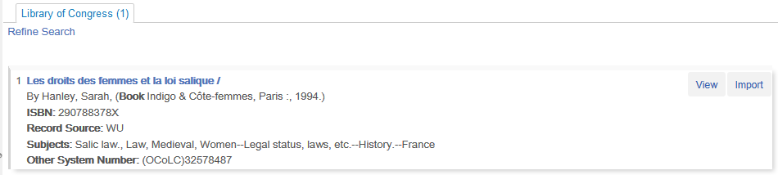
Introduction
For example here we search external resource “Library of Congress” for title Les droits des femmes et la loi salique and view it

Slide 5
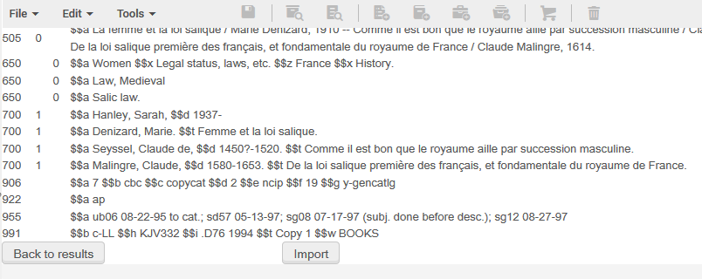
Introduction
We see that the record has several 900 fields and none of them indicate that the record is from the Library of Congress

Slide 6
Introduction
We want to remove the 9XX fields and add our own 900 fields which indicates that the record is from the Library of Congress.
This can be done as follows:
Create a normalization rule which does the desired change
Put the normalization rule in a normalization process
Add the process to the external search resource configuration

Slide 7
Creating the normalization rule

Slide 8
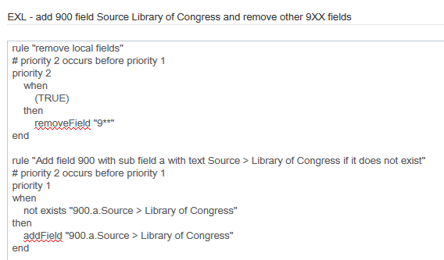
Creating the normalization rule
Here is a normalization rule which removes 9XX fields and then adds a 900 field indicating that the record was copied from the Library of Congress

Slide 9
Adding the normalization rule to a process

Slide 10
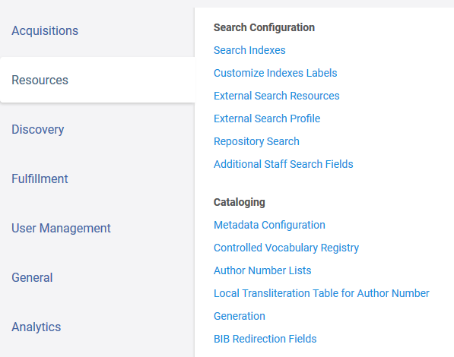
Adding the normalization rule to a process
The normalization rule we created is called “EXL - add 900 field Source Library of Congress and remove other 9XX fields”
Now we make a normalization process which uses this normalization rule.
Configuration > Resources > Cataloging > Metadata Configuration

Slide 11
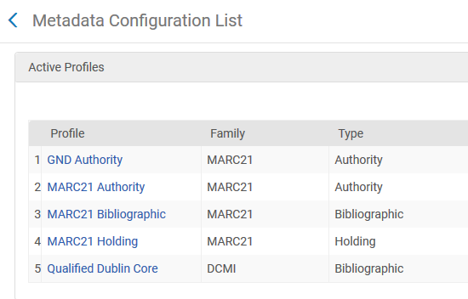
Adding the normalization rule to a process
Choose “MARC21 Bibliographic”

Slide 12
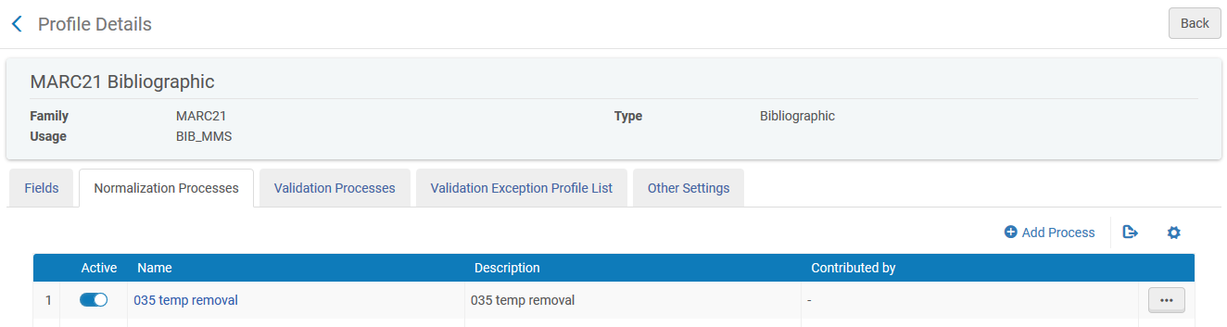
Adding the normalization rule to a process
In “Normalization Process” tab click “Add a Process”

Slide 13
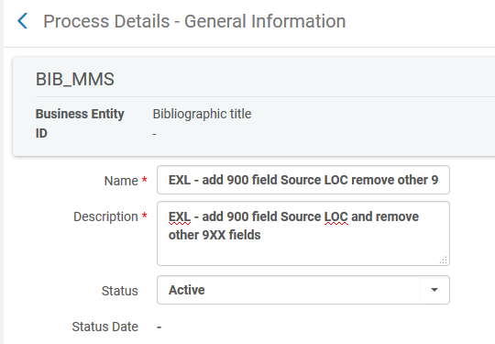
Adding the normalization rule to a process
Call the Normalization Process whatever you want and click “Next”.
Here we called it “EXL - add 900 field Source LOC remove other 9XX”.

Slide 14
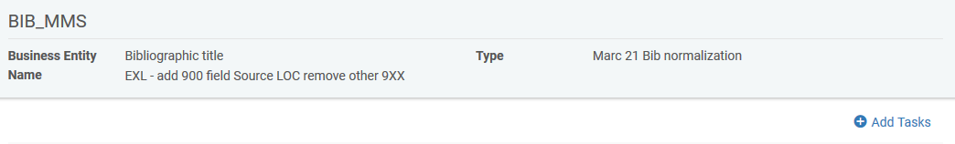
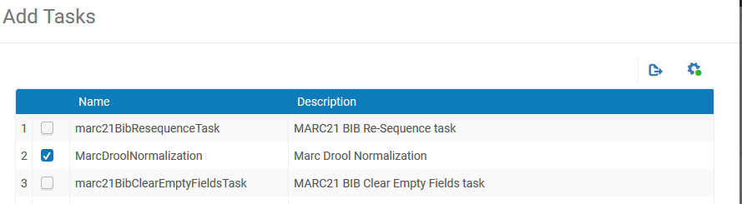
Adding the normalization rule to a process
Click “Add Tasks” and choose MarcDroolNormalization
Click “Next”

Slide 15
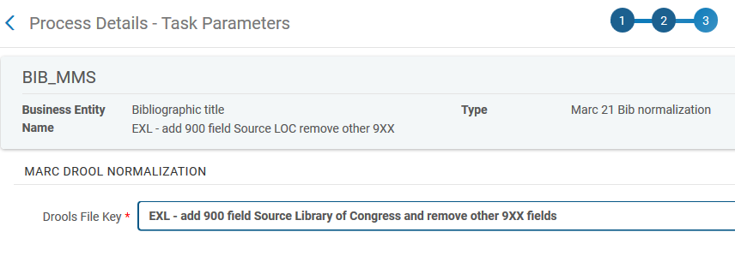
Adding the normalization rule to a process
In the “Drools File Key” field choose the Normalization Rule we already made, which is called “EXL - add 900 field Source Library of Congress and remove other 9XX fields”
The process can now be used throughout the various places in Alma where normalization processes are used.

Slide 16
Add normalization process to external resource

Slide 17
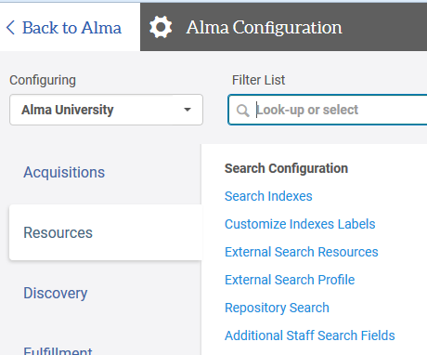
Add normalization process to external resource
Edit the profile at Configuration menu > Resources > Search Configuration > External Search Resources

Slide 18
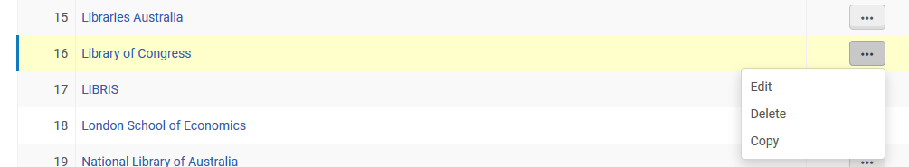
Add normalization process to external resource
Edit specific resource

Slide 19
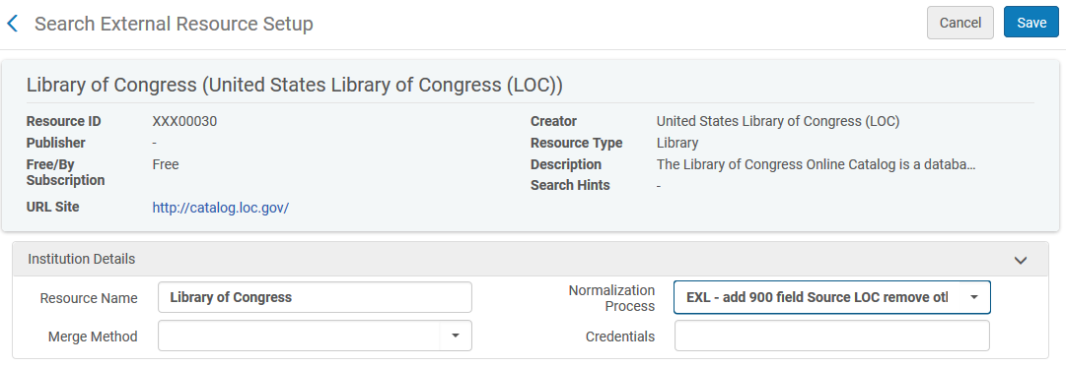
Add normalization process to external resource
In the field “Normalization Process” put the desired normalization process.
Here we put the one we made a moment ago called “EXL - add 900 field Source LOC remove other 9XX”.

Slide 20
Testing the normalization process in external resource

Slide 21
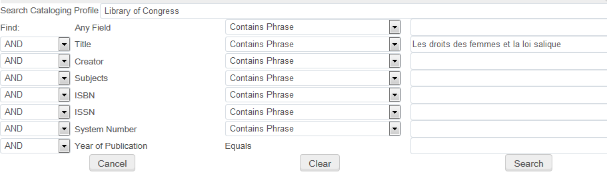
Testing the normalization process in external resource
Now we will again search Library of Congress for the same title “Les droits des femmes et la loi salique“

Slide 22
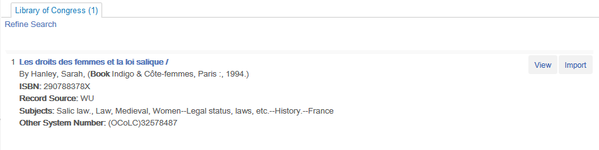
Testing the normalization process in external resource
We will view the record

Slide 23
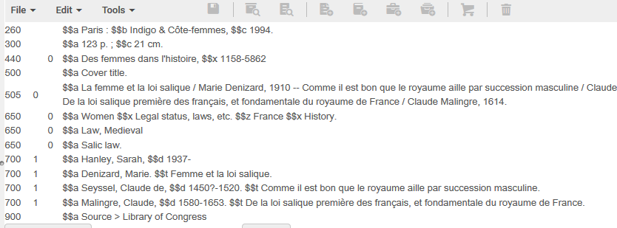
Testing the normalization process in external resource
The original 9XX fields are gone and our 900 field has been added
All 9XX fields we previously saw before editing the external search resource are gone.

Slide 24
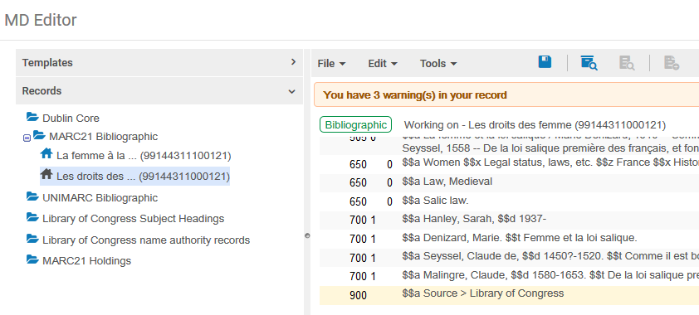
Testing the normalization process in external resource
This is also reflected in the catalog after importing

Slide 25
Yoel.Kortick@exlibrisgroup.com

